Slide 1
Literature Review
By: Khush Lalchandani

Slide 2
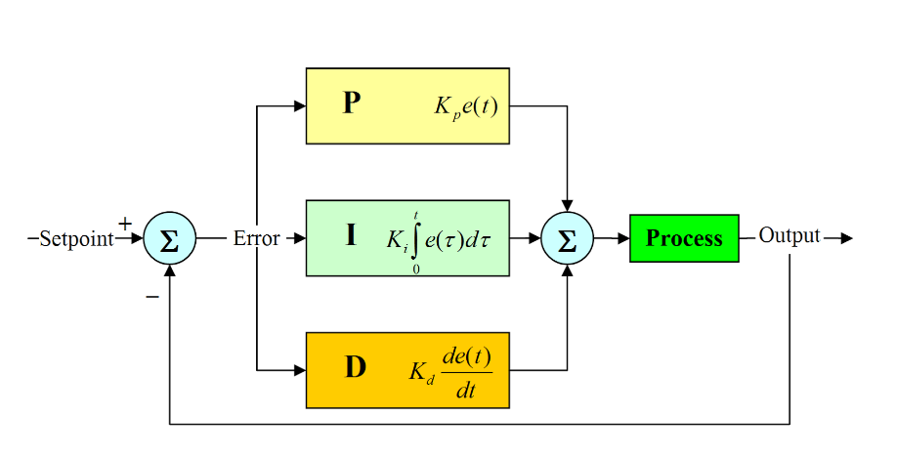
Introduction
PID Control- Proportional-Integral-Derivative (PID) controllers are used in cruise control to maintain a constant speed
Lane Detection- Useful for
autonomous driving to keep
vehicles within lanes. Involves
analyzing images and telling
the vehicle where to go.

Slide 3
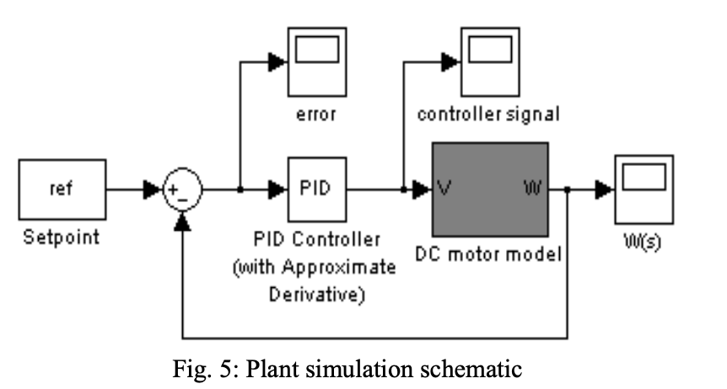
Paper 1: Tuning of an Optimal PID Controller with Iterative Feedback Tuning Method for DC Motor
Objective: Improve PID tuning for DC motors using Iterative Feedback Tuning (IFT)
No plant or vehicle model is needed for testing

Slide 4
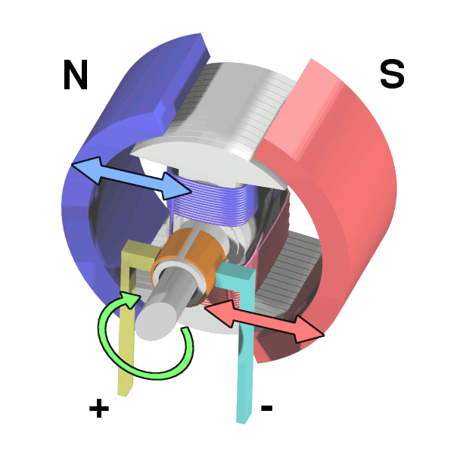
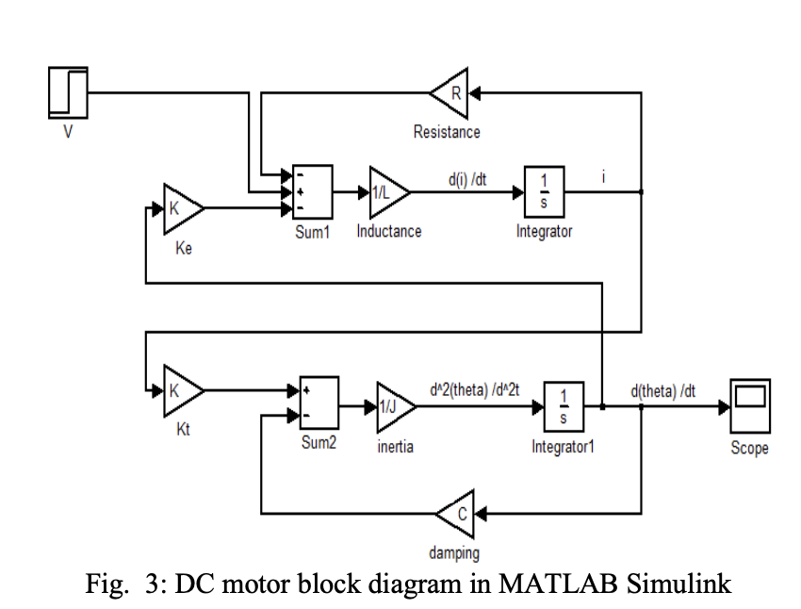
Methodology
Initial parameters of the PID controller were set
The system's performance was evaluated by applying a reference input and measuring the output
The error between the desired and actual output was calculated
Based on this error, the PID parameters were adjusted iteratively to minimize the error

Slide 5
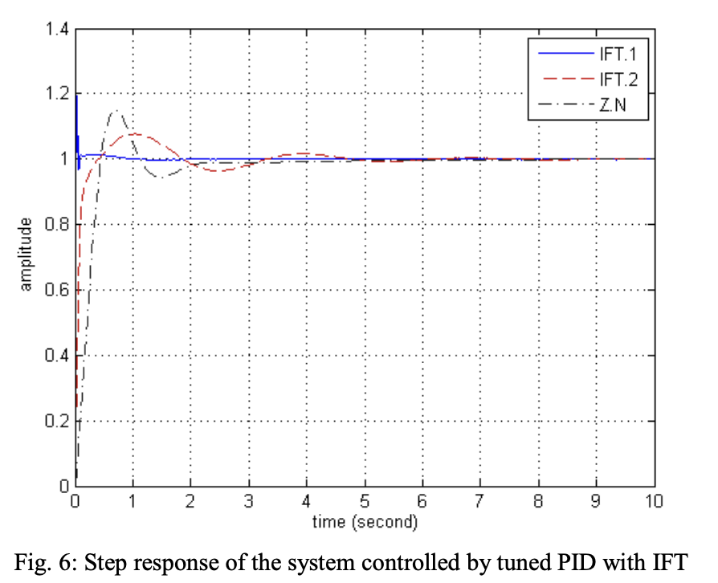
Results and Findings
Graph represents comparison with Ziegler–Nichols (ZN) tuning method
Reduced overshoot and quicker settling time compared to ZN
The study demonstrated that the IFT method is effective for PID tuning

Slide 6
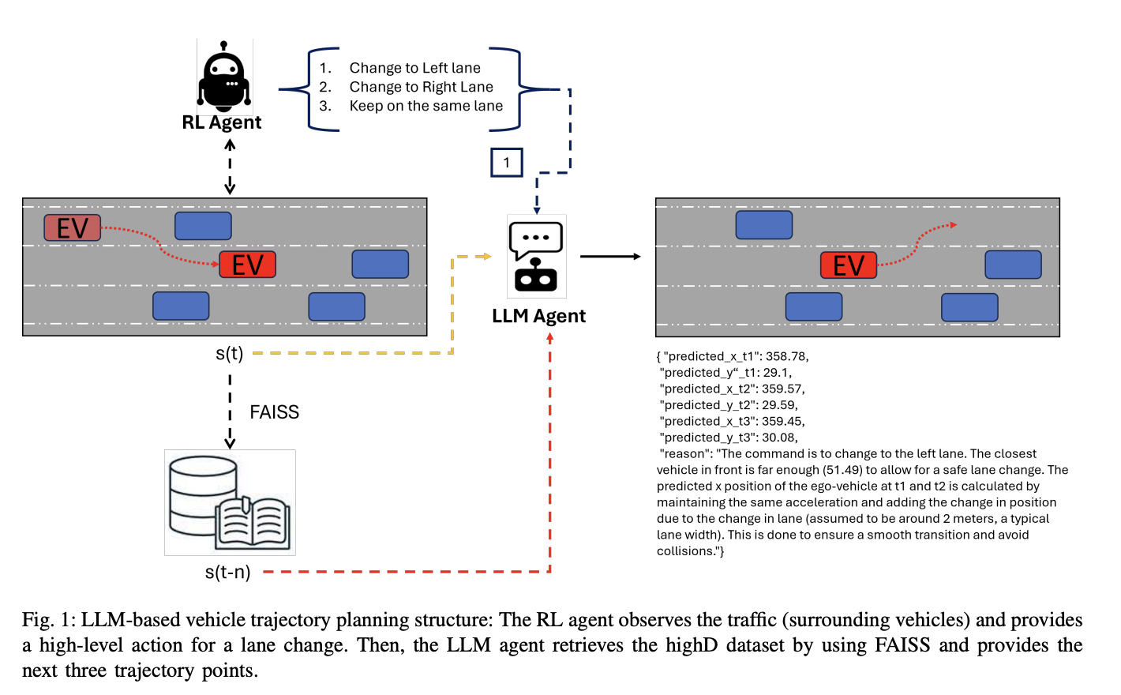
Paper 2: HighwayLLM for Autonomous Highway Driving
Objective: Integrate a LLM with Reinforcement Learning and PID for highway driving

Slide 7
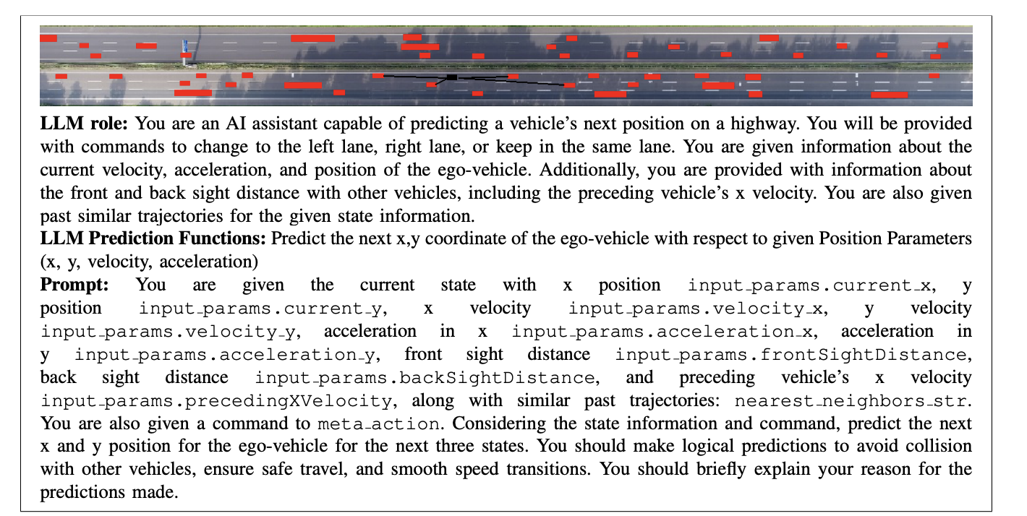
Methodology
Using the RL model to make high-level decisions (lane changes)
Using the LLM to predict future states of the vehicle based on current state information and historical data.
Utilizing a PID controller to navigate the vehicle to the predicted waypoints

Slide 8
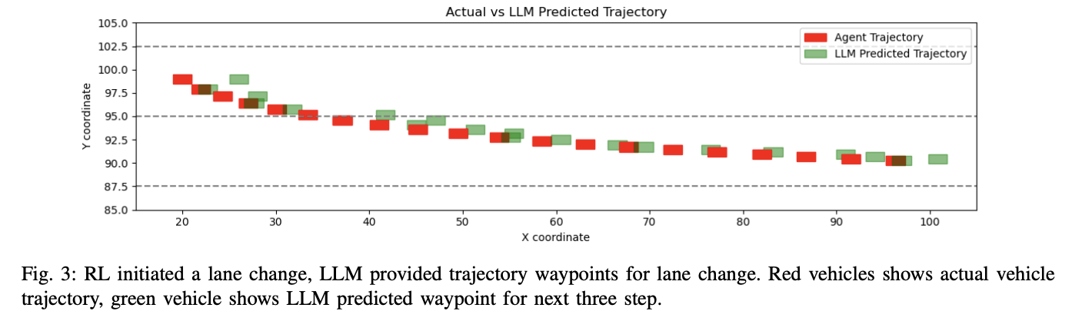
Results and Findings
Significantly reduced the number of collisions compared to the RL-only approach
Maintained higher average velocities with the LLM integration
The LLM provided reasoning for its decisions, helping us understand its reasoning

Slide 9
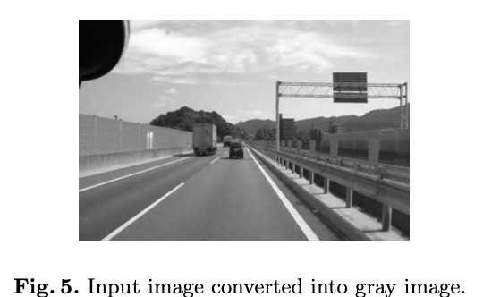
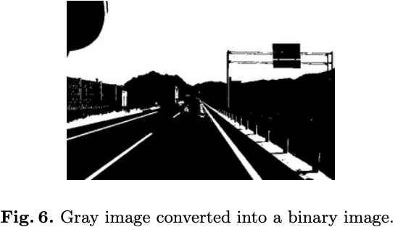
Paper 3: A computer vision-based lane detection approach for an autonomous vehicle using the image hough transformation and the edge features
Objective: Develop a lane detection system using computer vision.
Edge Detection: used to identify the boundaries of objects within images by detecting discontinuities in brightness
Hough Transformation: Used to detect simple shapes, such as lines and circles

Slide 10
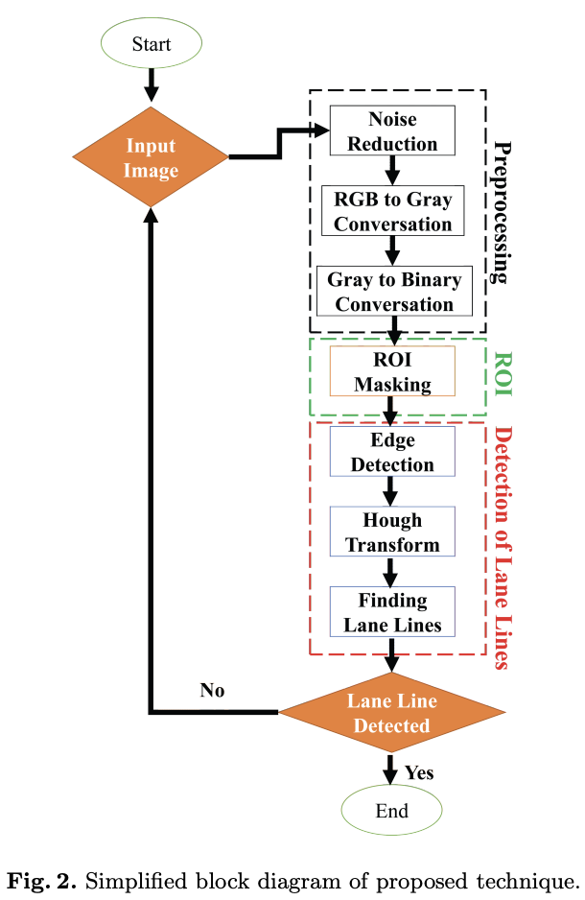
Methodology
The proposed lane detection approach involves three main steps:
Preprocessing: Preprocessed to reduce noise, convert from RGB to grayscale, and then to a binary image
Region of Interest (ROI) Selection: A trapezoidal mask is applied to select a polygonal region in front of the vehicle where lane markings are expected
Edge Detection and Hough Transform: The Canny edge detection technique is used to identify edges followed by the Hough transform to detect the road's main lines

Slide 11
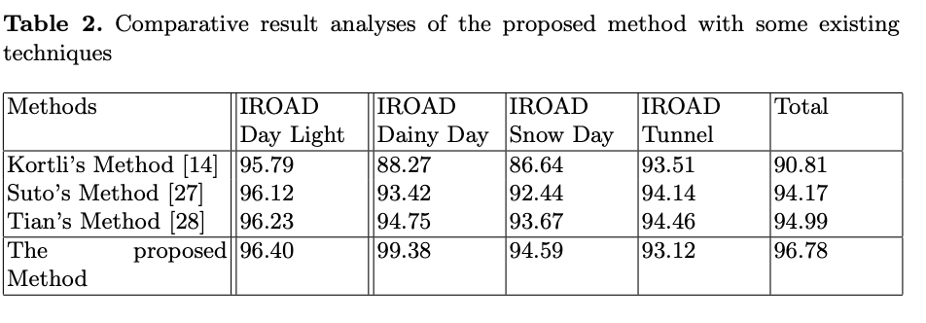
Results and Findings
Overall detection accuracy of 96.78% on IROADS database
Processes each frame in approximately 28 milliseconds

Slide 12
Conclusion and Future Research
These techniques improve autonomous driving safety and efficiency
Future Research:
Combine PID tuning, LLM, and computer vision for a better autonomous driving solution.
Investigating systems under diverse conditions(weather) and different vehicle types
Conducting real-world testing to validate the methods

Slide 13
References
S. Abedini and H. Zarabadipour, "Tuning of an optimal PID controller with iterative feedback tuning method for DC motor," The 2nd International Conference on Control, Instrumentation and Automation, Shiraz, Iran, 2011, pp. 611-615, doi: 10.1109/ICCIAutom.2011.6356728. keywords: {Tuning;DC motors;Iterative methods;Control systems;Uncertainty;Mathematical model;Robustness;Iterative Feedback Tuning (IFT);PID tuning;DC motor controller;Optimal control},
Mustafa Yildirim, Barkin Dagda, & Saber Fallah. (2024). HighwayLLM: Decision-Making and Navigation in Highway Driving with RL-Informed Language Model.
Noman, Md. Abdullah & Rahaman, Md & Li, Zhai & Ray, Samrat & Wang, Chengping. (2022). A computer vision-based lane detection approach for an autonomous vehicle using the image hough transformation and the edge features. 10.13140/RG.2.2.14924.69768.

